Slide 1
E-SAMPLING
MISS DIOR
ROSE N’ROSES
12th of April 2021

Slide 2
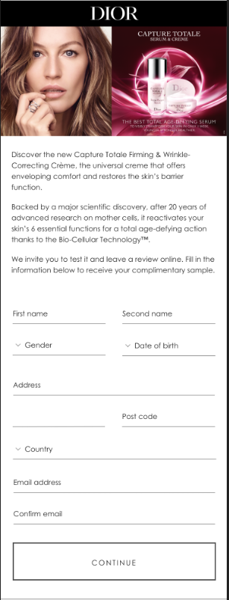


INTERFACE
Replace Capture Total visual with Miss Dior visual
Keep same DIOR banner on top
Please replace text with below (keep text below the red line):
The House of Dior is pleased to introduce you to Miss Dior Rose N’Roses.
A sparkling floral Eau de Toilette, Thousands of fresh and colorful Grasse rose petals, brightened by a flight of dewy citrus. The energy of a sparkling floral.

Slide 3
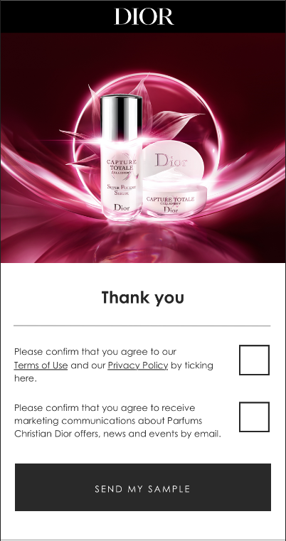
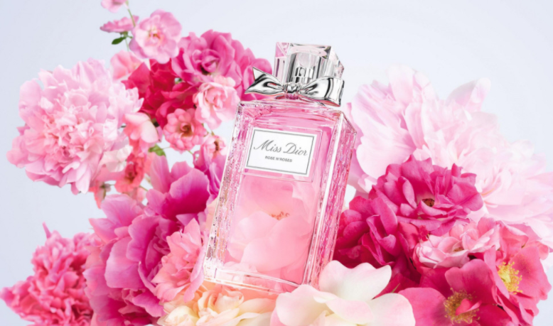
INTERFACE
Replace Capture Total visuall with Miss Dior visual
Keep same DIOR banner on top
Use the same thank you text

Slide 4
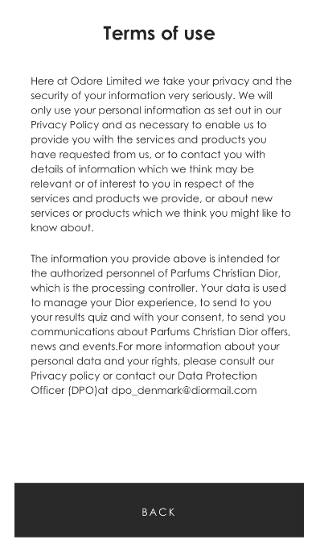
TERMS OF USE
Use the same Terms of use

Slide 5
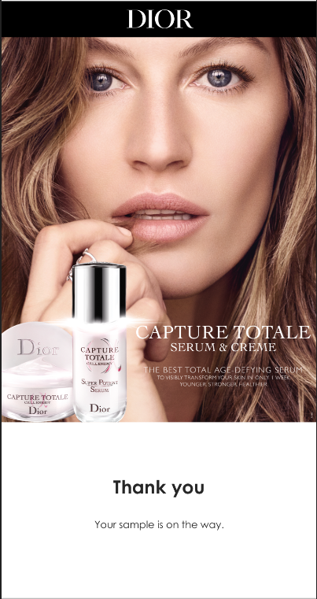

THANK YOU
Update Capture Total visual with Miss Dior visual
Keep DIOR banner on top
Keep same text

Slide 6
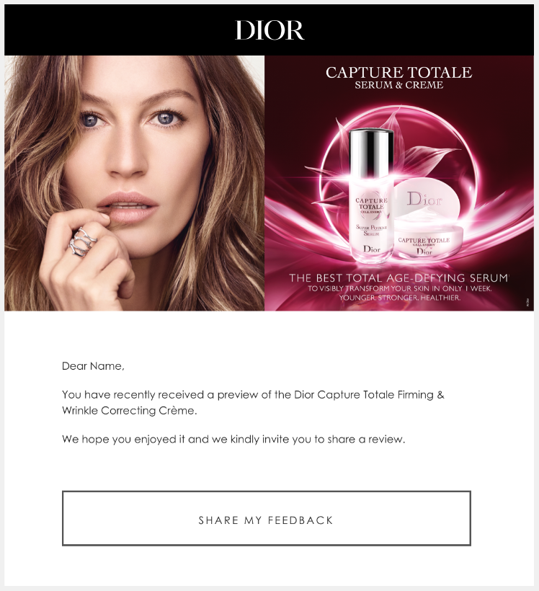

RECALL EMAIL
Replace Capture Total visual with Miss Dior Roses.
Keep DIOR banner on top
Replace text with:
You have recently received a sample of Miss Dior Rose N’Roses.
We hope you enjoyed it and we kindly invite you to share a review.

Slide 7

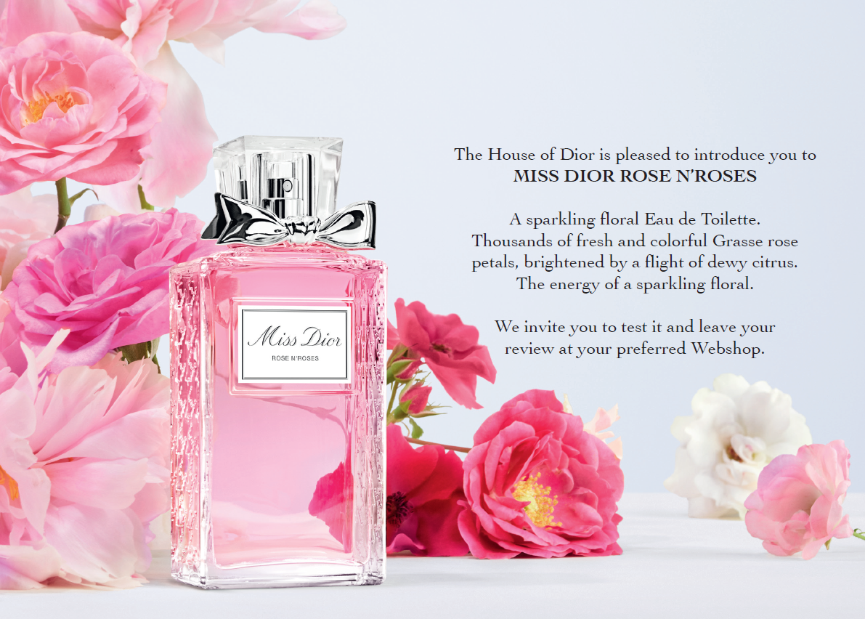
SAMPLING CARD

